Slide 1

IPL DATA Analysis USING PYTHON & EDA
Created by
Arun Kumar
GCD @INSAID

Slide 2
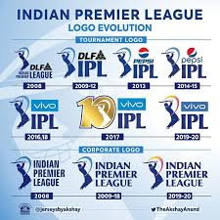
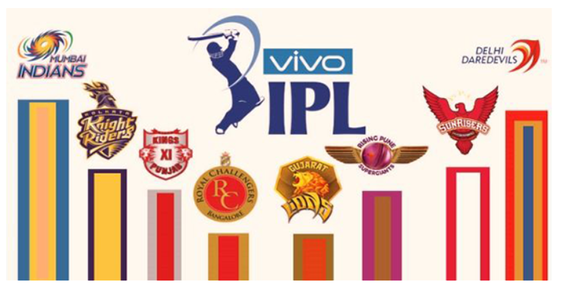
IPL & teams logo

Slide 3
Table of Contents
Problem Statement & Pandas Packages
Dataset 1 & 2 along with Dataset Merging
Pandas Profiling
Exploratory Data Analysis
Team Performance’s in all IPL season
Individual Performance’s in all IPL season
Conclusion and Actionable Insights

Slide 4
1. Problem Statement
The Indian Premier League (IPL) is a professional Twenty20 cricket league in India contested during March or April and May of every year by eight teams representing eight different cities in India.
The league was founded by the Board of Control for Cricket in India (BCCI) in 2008. The IPL is the most-attended cricket league in the world. By analyzing the players on different aspects like Batting, Bowling and Fielding, let us try to find the value they add to their teams and thus the role they play in winning the tournament.
Importing Packages
import pandas as pd
import numpy as np
import matplotlib.pyplot as plt
import seaborn as sns
import pandas_profiling
from pandas_profiling import ProfileReport

Slide 5
Dataset 1 & 2 with Merging
Dataset 1:
The First Dataset contains numbers of matches played by each team in all IPL season 2008- 18. This dataset contains 696 rows and 18 columns. Columns name holds the different information about the matches .
Examples: “Season” columns shows about the season the match has been played.
Dataset 2:
The second Dataset contains number of Deliveries has been bowled in all IPL season 2008- 18. This dataset contains 164750 rows and 21 columns. Columns name holds the different information about the matches .
Examples: “Batsman” column shows which batsman is playing that over and ball.

Slide 6
3. Pandas Profiling
Once both the Datasets has been merged on the basis of Match Id’s we are going to import a powerful tool in Pandas library called Pandas Profiling.
We perform Pandas Profiling to know more about our Dataset and we quickly do an EDA.
In short, what pandas profiling does is save us all the work of visualizing and understanding the distribution of each variable. It generates a report with all the information easily available.
Type inference: detect the types of columns in a dataframe.
Essentials: type, unique values, missing values
Quantile statistics like minimum value, Q1, median, Q3, maximum, range, interquartile range
Descriptive statistics like mean, mode, standard deviation, sum, median absolute deviation, coefficient of variation, kurtosis, skewness.
Most frequent values
Histogram

Slide 7
4. Exploratory Data Analysis
Exploratory Data Analysis (EDA) is an approach to analyzing data sets to summarize their main characteristics, often with visual methods.
It includes cleaning, munging, combining, reshaping, slicing, dicing, and transforming data for analysis purpose.
The primary goal of EDA is to maximize the analyst's insight into a data set and into the underlying structure of a data set, while providing all the specific items that an analyst would want to extract from a data set, such as:
A list of outliers.
A good-fitting model.
Estimates for parameters.
Uncertainties for those estimates.
A ranked list of important factors.
Conclusions as to whether individual factors are statistically significant.
A sense of robustness of conclusions.
Optimal settings.

Slide 8
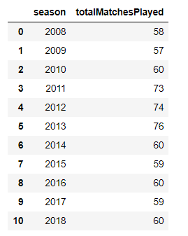
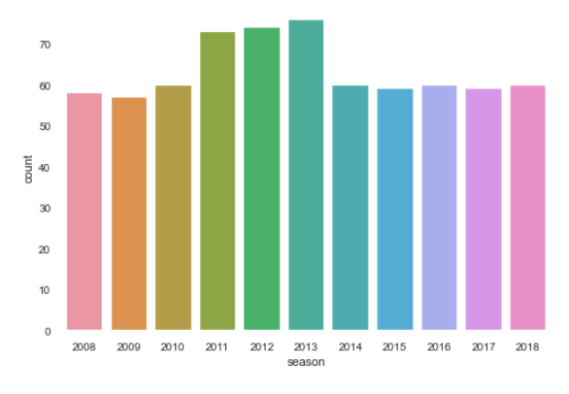
5. Team Performance’s in all IPL season
Matches played in each season

Slide 9
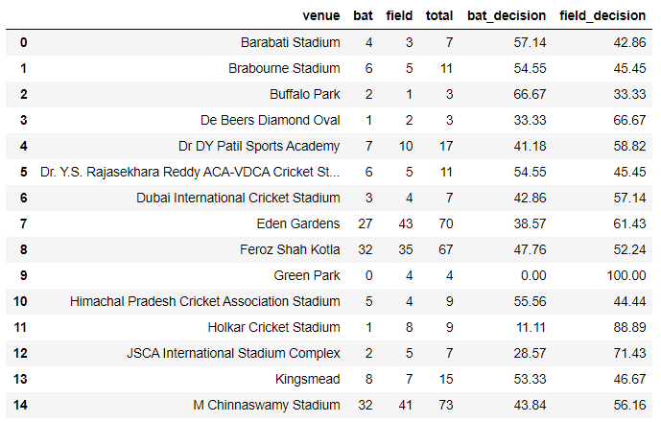
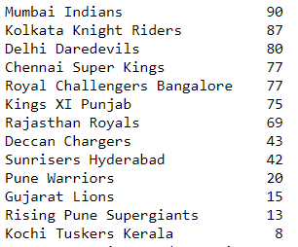
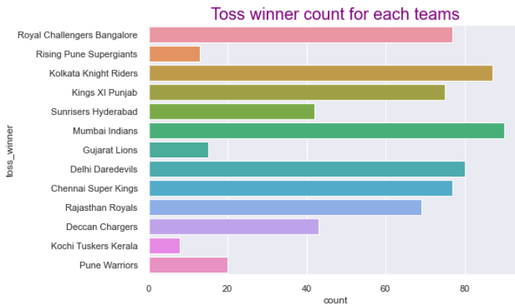
Toss Decision
Toss Decision in venues
Toss Winner Counts by Teams

Slide 10
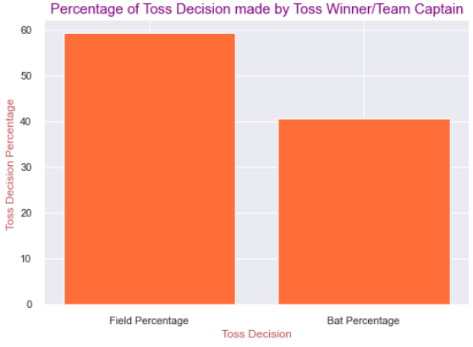
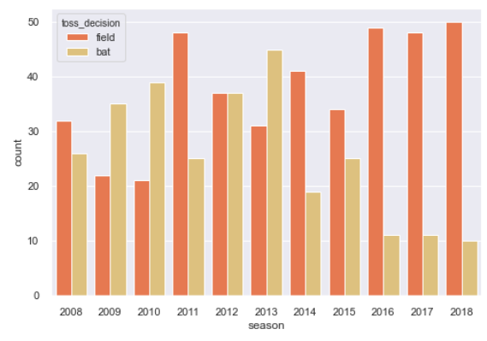
Toss Decision
Toss Decision Percentage
Toss Decision Count in each season

Slide 11
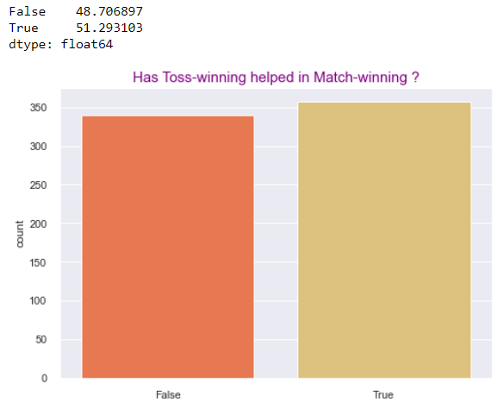
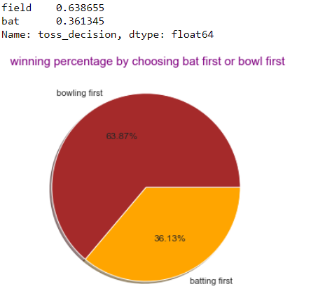
Toss Decision
Toss-winning helped in Match-winning
Winning percentage

Slide 12
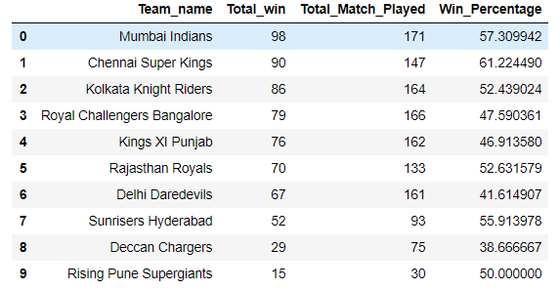
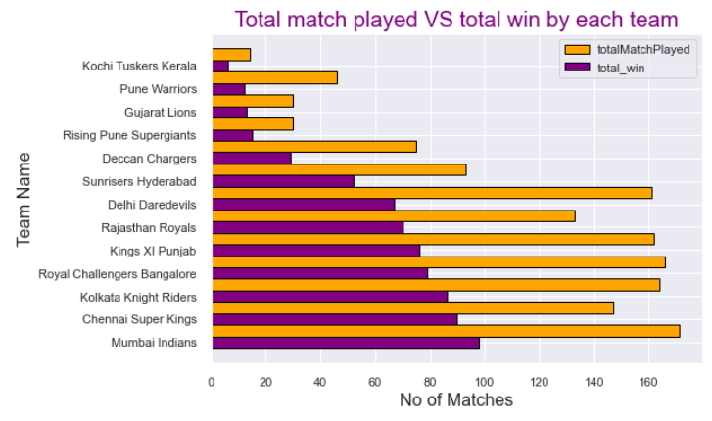
Matches Played By the team
Win Percentage of the teams
Total matches played by each team and their victories

Slide 13
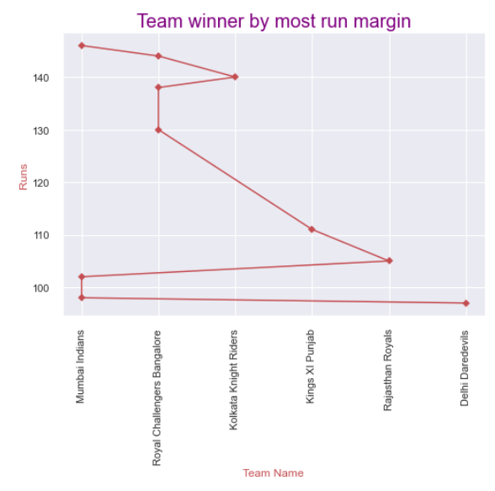
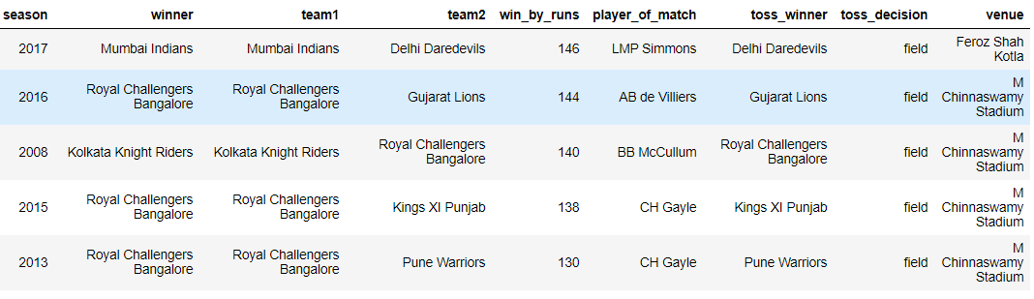
WIN Margin by Runs

Slide 14
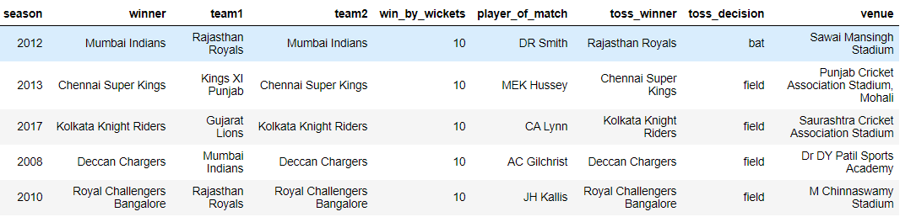
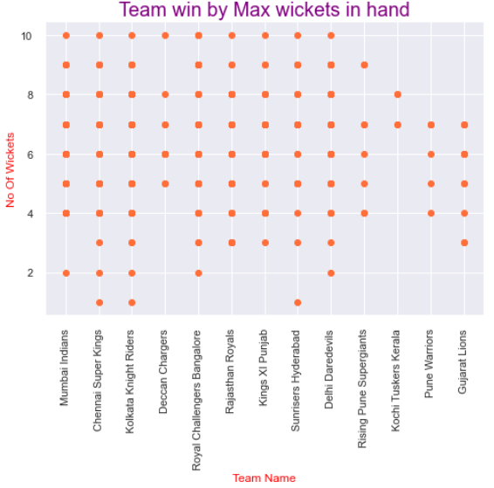
WIN Margin by Wickets

Slide 15
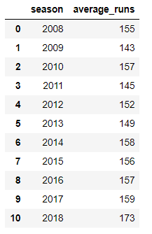
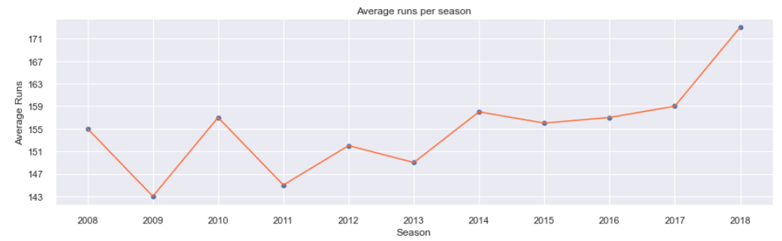
Average runs in each season

Slide 16
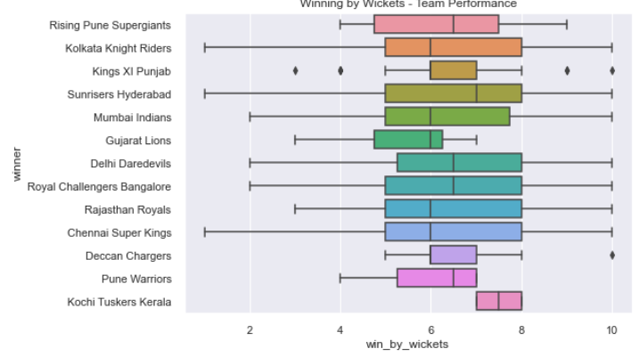
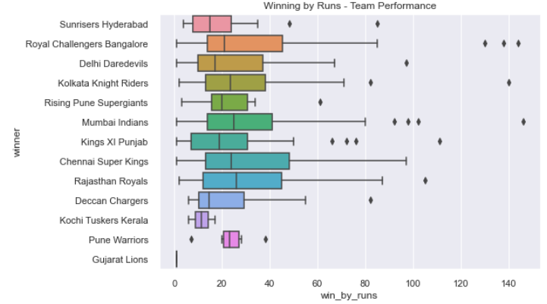
Average win by wickets & Runs by each team

Slide 17
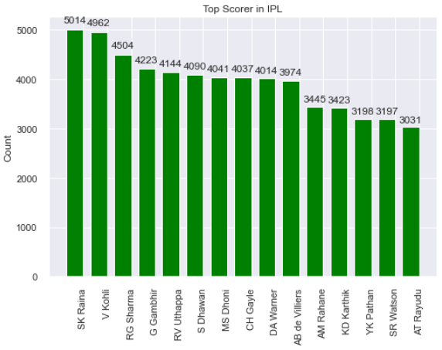
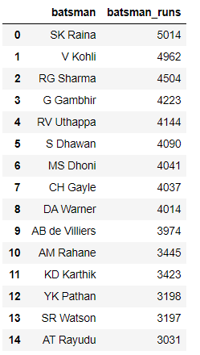
6. Individual Performances Batsman Performance Analysis
Batsman high scores in IPL

Slide 18
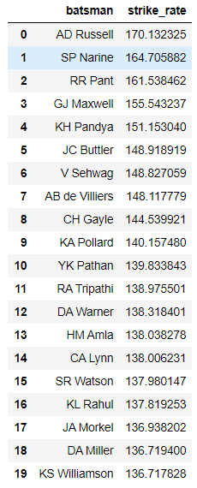
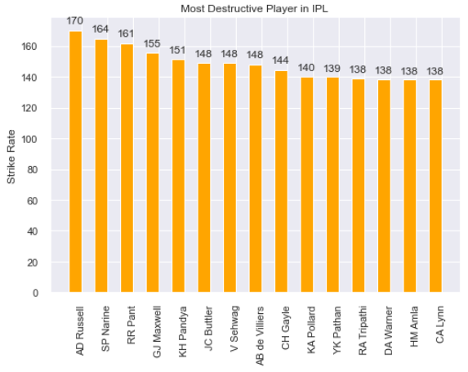
Batsman’s Performance Analysis
Highest Strike Rate

Slide 19
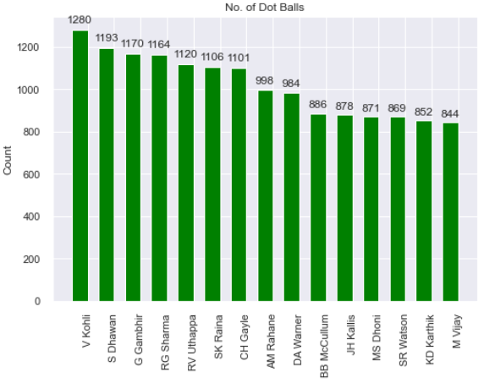
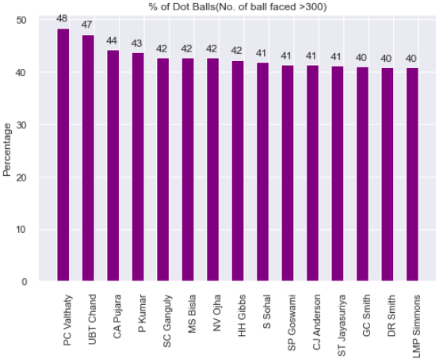
Batsman’s performance Analysis
Batsman with dot balls in IPL
Percentage of dot balls

Slide 20
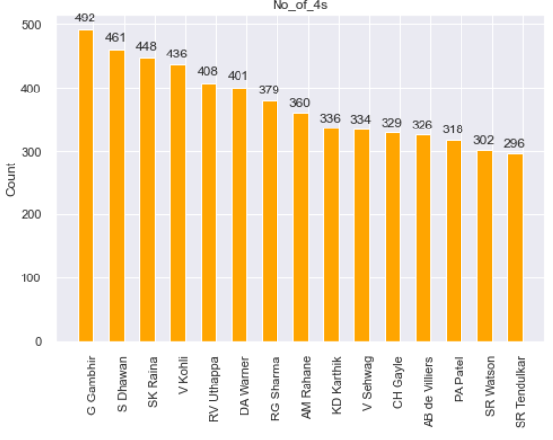
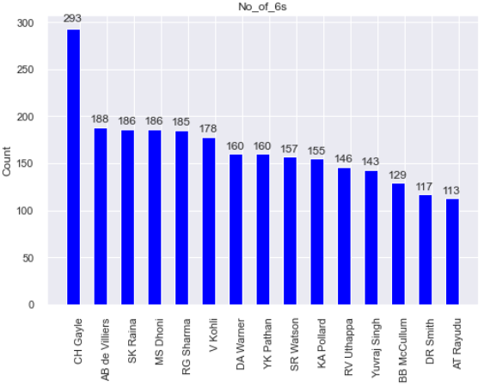
Batsman’s Performance Analysis
Batsman hitting Fours
Batsman hitting Sixes

Slide 21
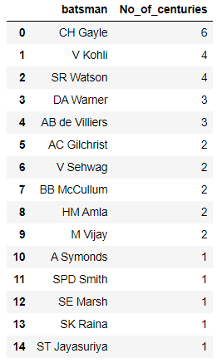
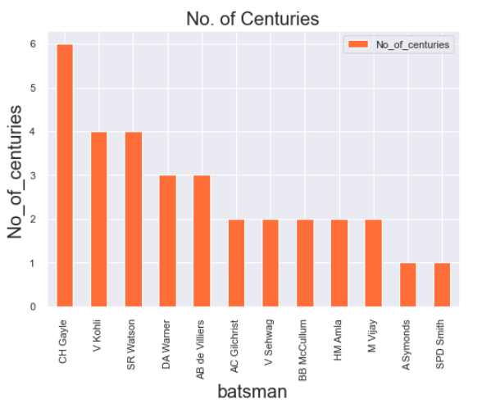
Most Centuries in IPL

Slide 22
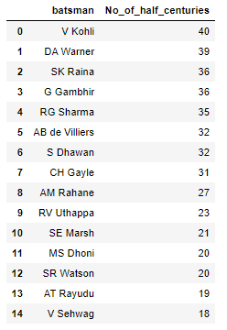
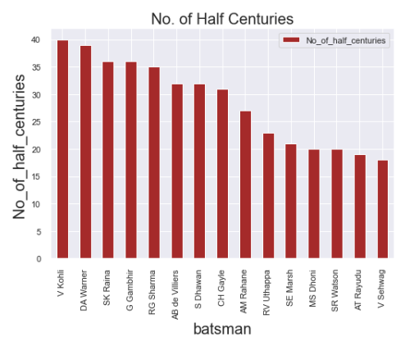
Most Half-Centuries in IPL

Slide 23
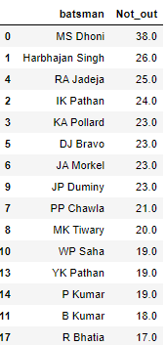
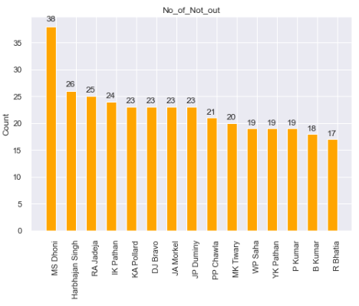
Most number of Not out Batsman’s in IPL

Slide 24
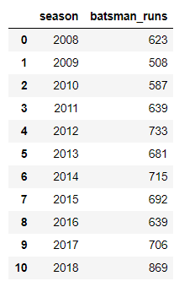
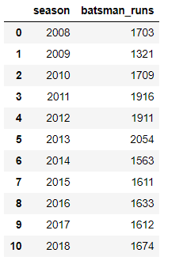
Total 6’s and 4’s in each season
Total 6’s in each season
Total 4’s in each season

Slide 25
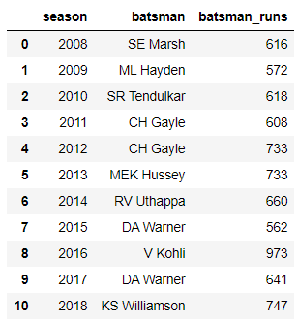
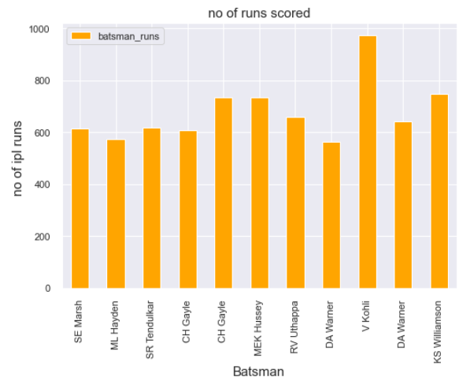
Orange Cap Holders in each season

Slide 26
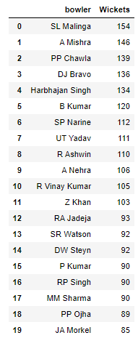
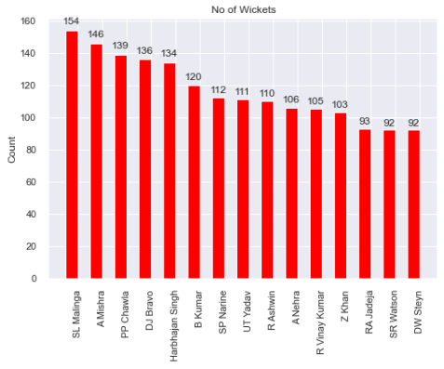
Bowler Performance Analysis Highest Wickets

Slide 27
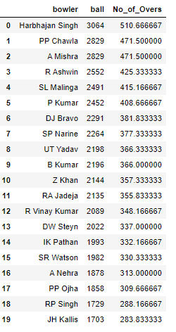
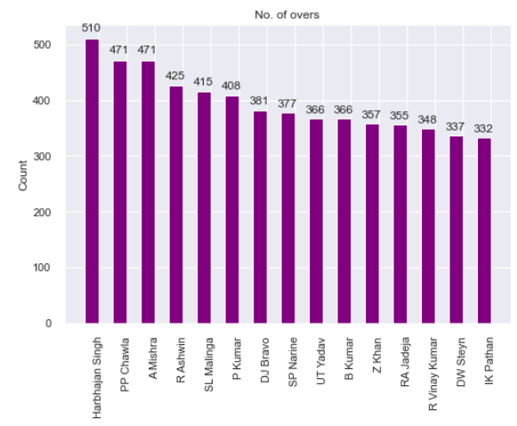
No. of overs bowled in IPL

Slide 28
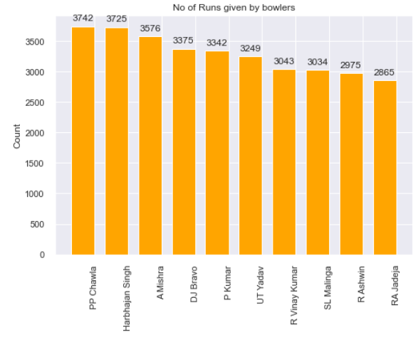
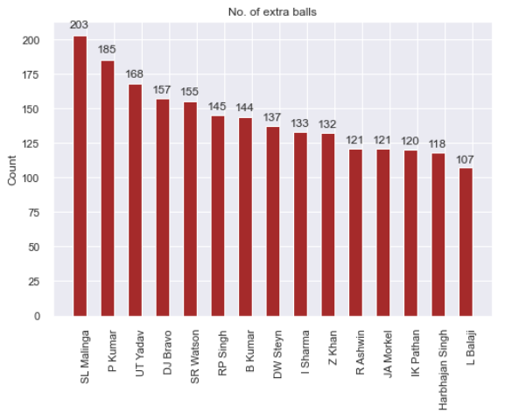
Bowler’s Performance Analysis
Runs Given by bowler
Bowler with extras

Slide 29
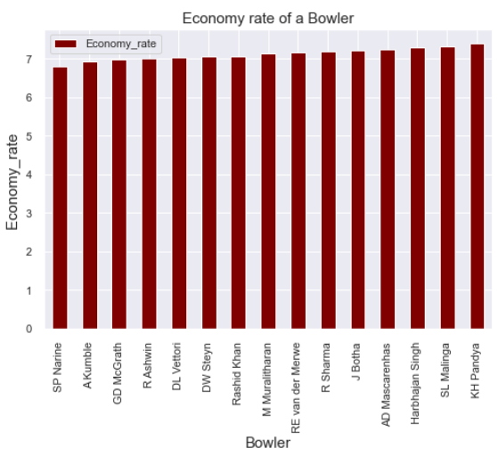
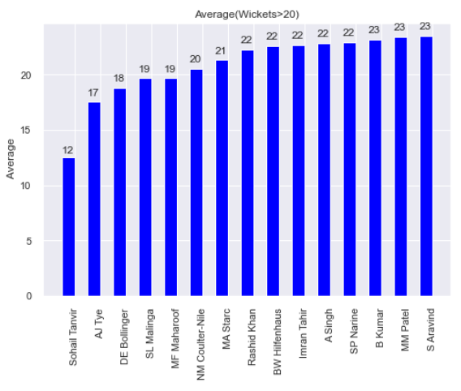
Bowler’s Performance Analysis
Economy of bowler
Bowlers Average of wickets

Slide 30
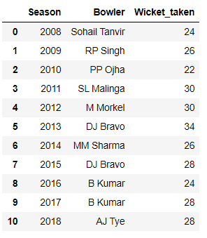
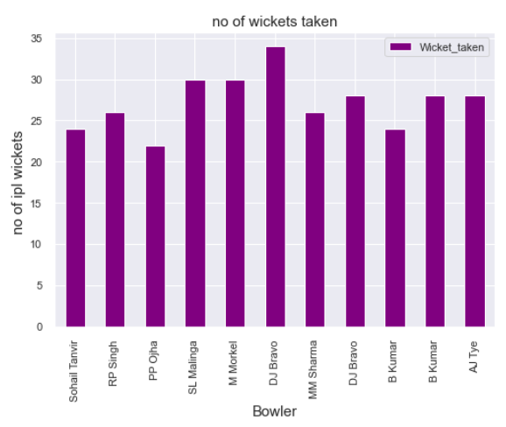
Purple Cap Holders in each season

Slide 31
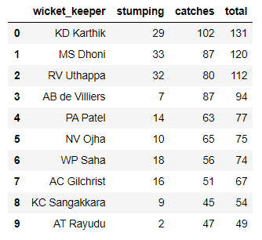

Fielders – Wicket Keepers
Wicket Keepers Catches and Stumping

Slide 32


Fielders - Catches

Slide 33

Seasons highest score

Slide 34












victories by the team in each season

Slide 35

IPL Winning Team in each season

Slide 36
7. Conclusion & actionable insights
It is analyzed that the dataset has be splitted in "Teams", "Batsman", "Bowlers" and "Fielders"
IPL is all about team performance and the team who is best on that current day will be the winners.
Individual contributions plays a vital role in this modern game.
Earlier IPL was a Batsman's game. Later, it proved wrong.
Also IPL is all about young players/youngsters but, it is also a myth. Best example: 2018 Winners CSK with average age of players is 32.
IPL is very success because of Cricket fans in INDIA.
Mumbai Indians and Chennai Super Kings won the IPL title thrice, KKR won the title twice and RR, Deccan Charges and SRH won IPL once.
RCB, Delhi Daredevils, Kings XI Punjab didn't win the IPL titles.
RCB and Kings XI Punjab are runners twice and once respectively but, Delhi Daredevils didn't played finals yet.
Mumbai Indian didn't scored highest runs in any IPL season but, still they won 3 titles. Consistent is very important in this game.
Except 2014, the team who has Orange cap has never won the IPL title. Only Uthappa 2014 from KKR won the IPL title.
S Raina holds the record of max runs and max catches taken (non-wicket keeper). This is also one of the example of winning the title thrice.
Malinga has the max of wickets taken and that makes Mumbai Indians winning the title thrice.
V Kolhi has the most half centuries in IPL and 2nd in Centuries and highest run getter. That's why we call him as a Run Machine.
RCB, Delhi Daredevils, Kings XI Punjab need to change their strategies to win their maiden IPL title.
Few teams are more dependent on few individual players to perform all time. Every player needs to be contributed.

Slide 37

Thank YOU!!
Presented By
Arun Kumar
GCD @INSAID

